Slide 3
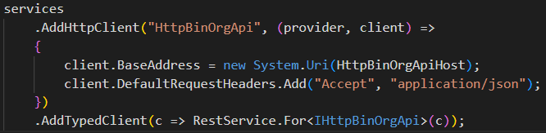

Slide 4
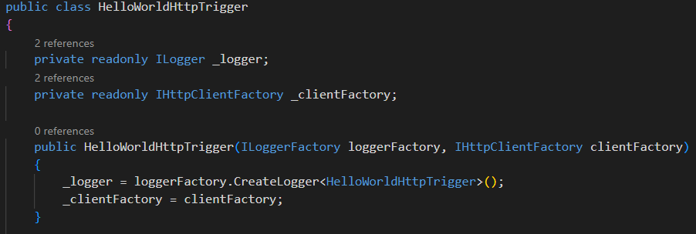
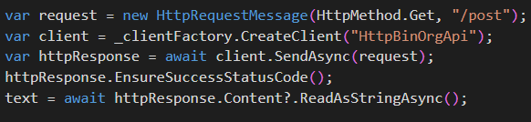
AddHttpClient(string name, IServiceCollections services);

Slide 5
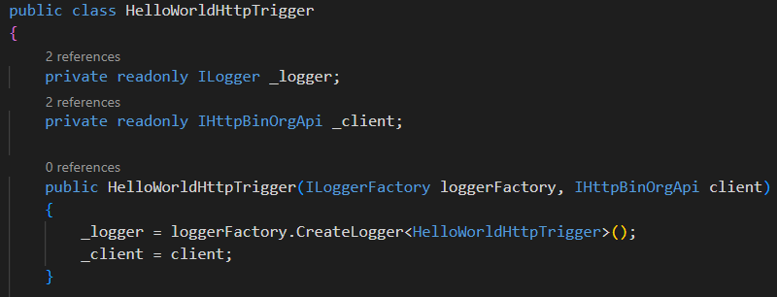
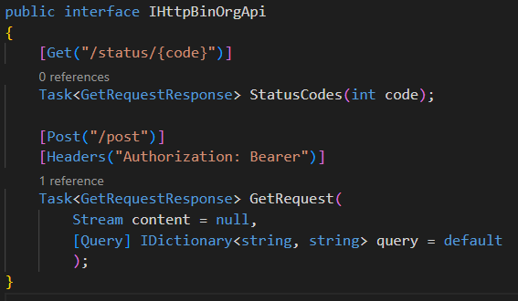
AddTypedClient(c => RestService.For<IHttpBinOrgApi>(c));

Slide 6
HttpClient handlers pipeline

Slide 7
Using HttpClient handlers to mock HTTP calls

Slide 8
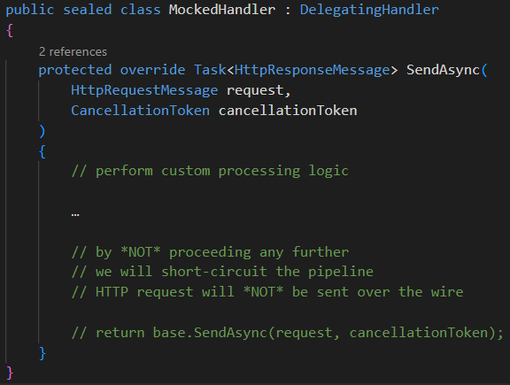
Using HttpClient handlers to mock HTTP calls

Slide 9



Using HttpClient handlers to authenticate HTTP calls

Slide 10
Using HttpClient handlers to authenticate HTTP calls

Slide 11
Using HttpClient handlers to authenticate HTTP calls

Slide 12
Putting it all together

